Slide 1


EDUCATION, SUSTAINABILITY, AND
TOURISM
WASTE & RECYCLING TOOLKIT
Presented by the American Shore and Beach Preservation Association

Slide 2
Resources Available to Sites
Slide Deck
Waste and Recycling Toolkit
Summer Series Recordings
Meeting Recording
Assistance meeting with program partners

Slide 3

LEGEND
Important
For Application
General

Slide 4

CRITERIA
ENVIRONMENTAL EDUCATION AND INFORMATION
Environmental Education Activities
Information about the Environment
Code of Conduct
WATER QUALITY
Frequent Water Sampling
Excellent Bathing Water Quality
Appropriate Sewage/Industrial Wastewater Management
ENVIRONMENTAL MANAGEMENT
Environmental Management Plan
Waste Management
Sustainable use of Resources
Adequate and Clean Facilities
Proper Maintenance
SAFETY AND SERVICES
Emergency Plans
Lifeguards and First-aid Equipment
Accident Prevention Measures
Risk Assessments
Access for All

Slide 5
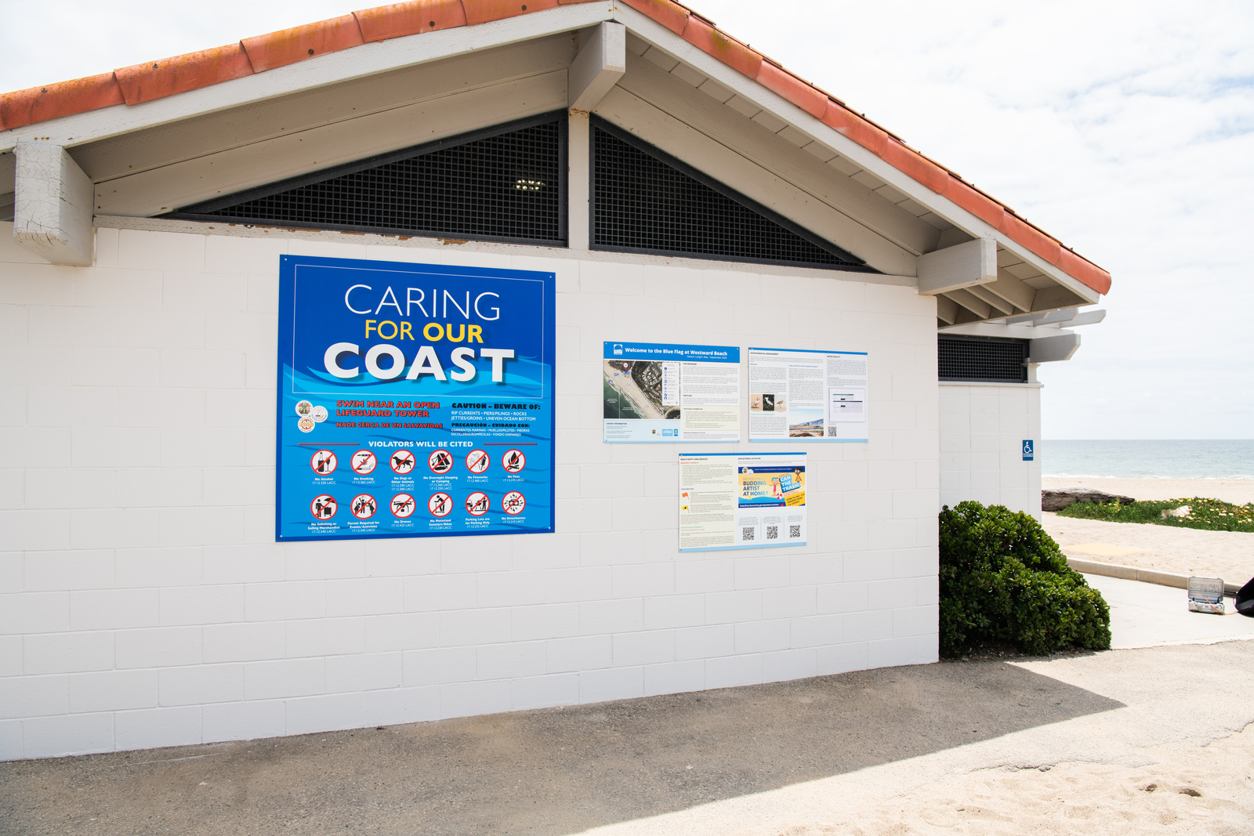
Criterion 6. A code of conduct that reflects appropriate laws and/or regulations governing the use of the beach and surrounding areas must be displayed.
  The code of conduct must address the activities of beach users.
  It must be included on the information board.
  It must include any rules on domestic animals, fishing, littering, camping, fires, zoning, etc.
  The period lifesaving equipment/lifeguards are available must also be on the information board.

Slide 6
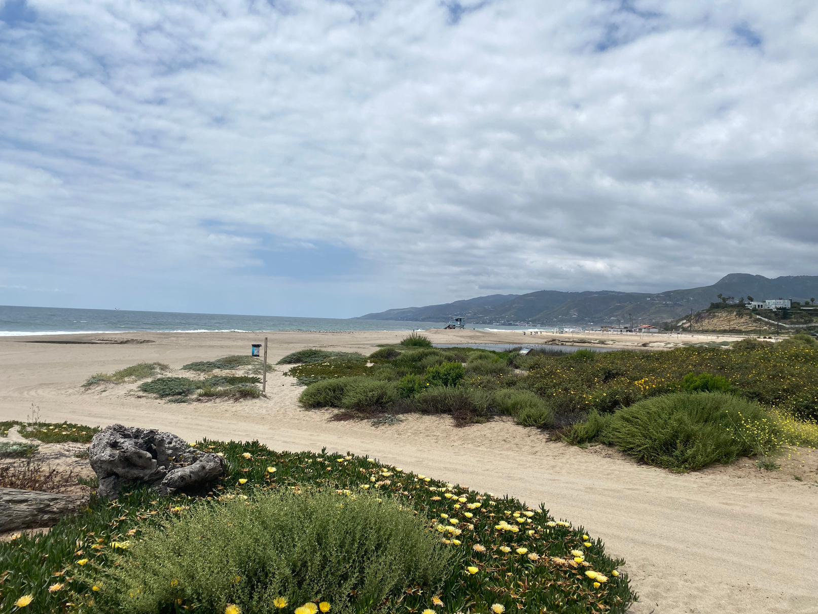
Criterion 15. The beach must be clean.
  Beaches, paths, and parking areas must be clean.
  Cleaning may be mechanical or manual.
  Cleaning must take into consideration flora, fauna, sensitive areas, and sensitive species.

Slide 7
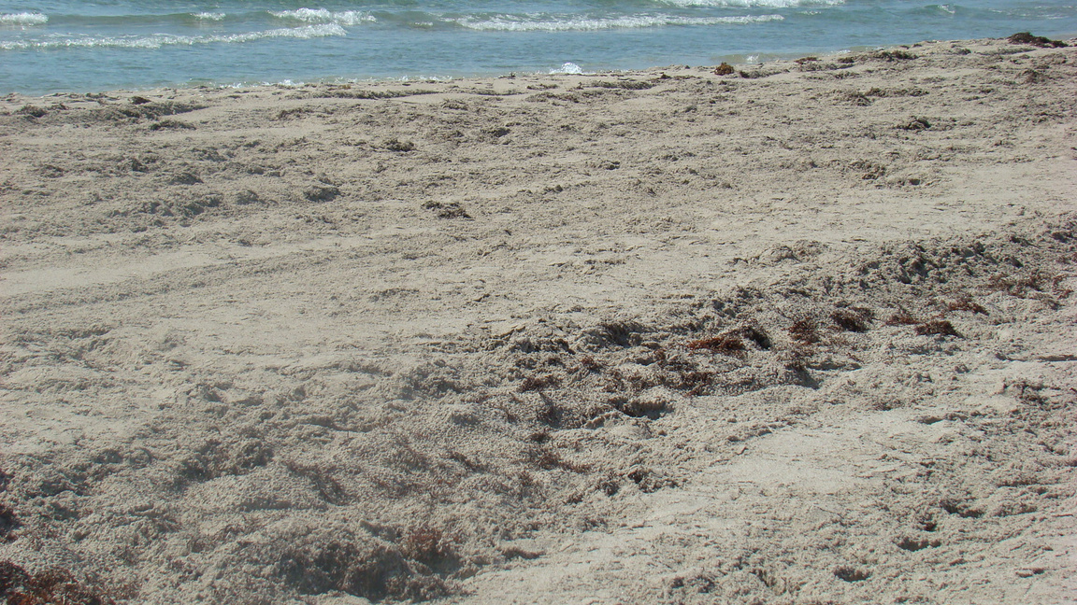
Criterion 16. Algal vegetation or natural debris must be left on the beach.
  Algal vegetation and natural debris must be left on the beach unless it has become a hazard or hinders access of users.
  Triggers for removal must be clearly identified in the beach management plan.
  If and when removal occurs, it is recommended to focus on limited areas and disposal in environmentally friendly ways.

Slide 8
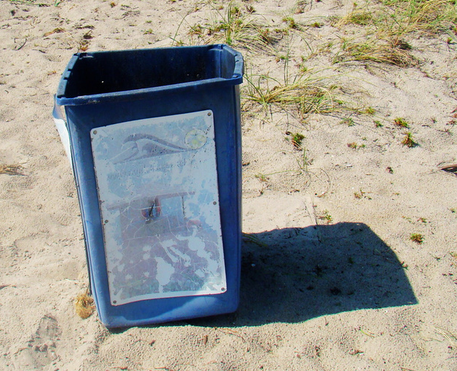

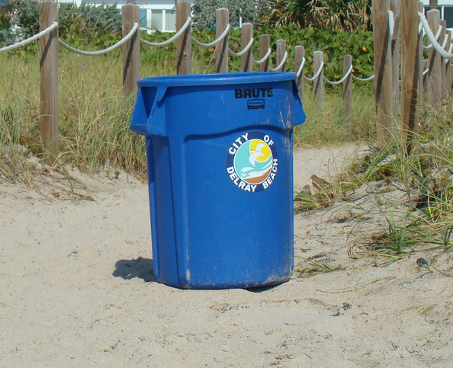
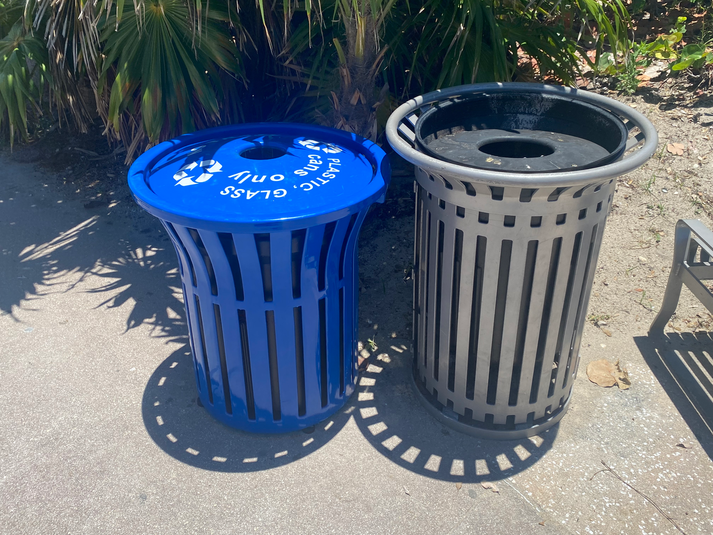
Criterion 17. Waste disposal bins/containers must be available at the beach in adequate numbers and they must be regularly maintained.
  Trash cans must be available, in adequate numbers, and regularly maintained.
  It is recommended cans be made of environmentally friendly products

Slide 9
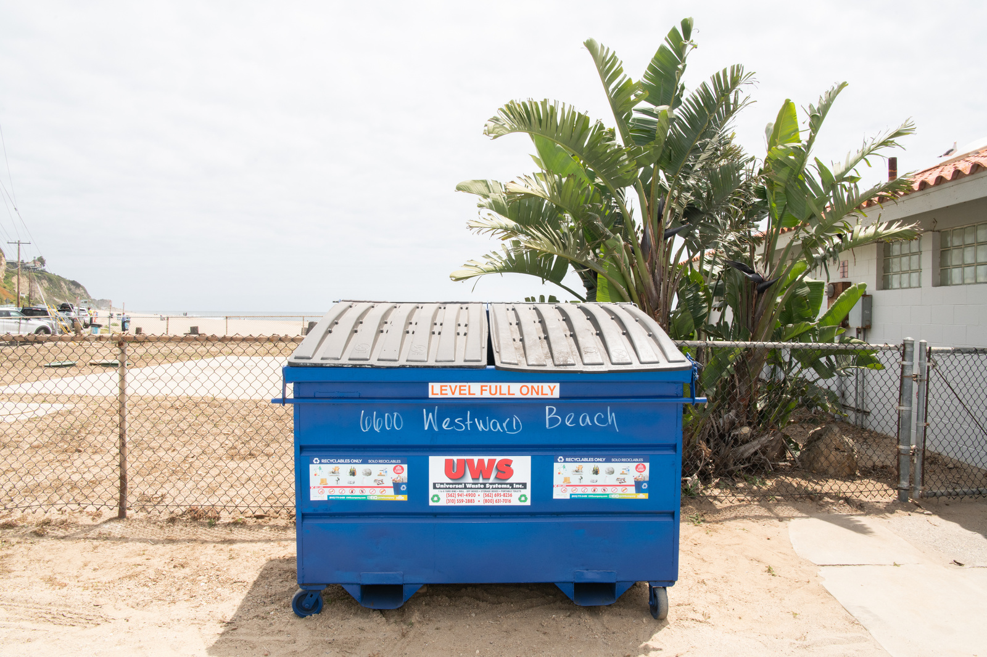
Criterion 18. Facilities for the separation of recyclable waste materials must be available at the beach.
  Containers must be available for recycling if there is a local facility.
  Recycling should accommodate the collection and separation of as many different materials as possible.

Slide 10
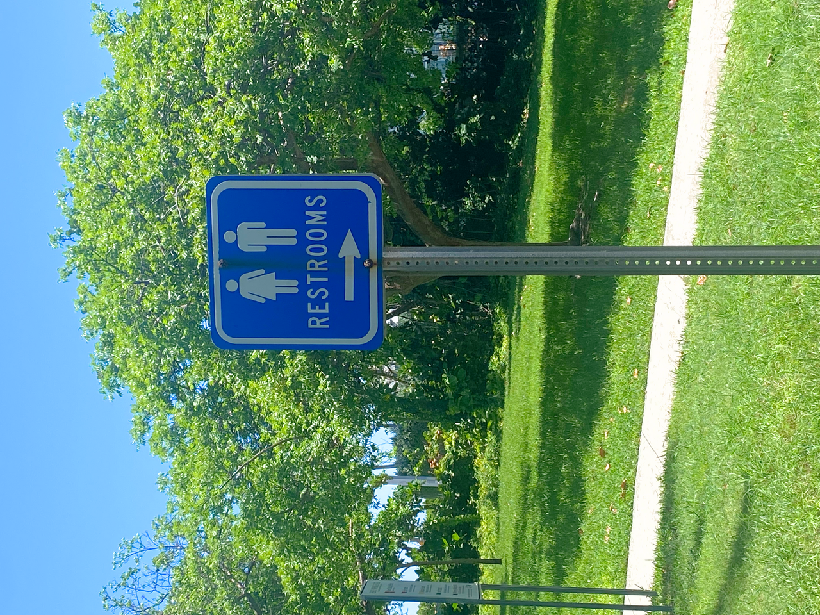
Criterion 21. The toilet or restroom facilities must have controlled sewage disposal.
  Sewage or effluent from toilet facilities must not enter the ground or water untreated.

Slide 11
Criterion 22. There must be no unauthorized camping or driving and no dumping on the beach
  Unauthorized camping, driving, and dumping must be prohibited.
  Locations that allow driving on the beach during the Blue Flag season must properly manage the practice through permitting and enforcement.
    You may be asked to provide additional details in your application as to these practices.

Slide 12
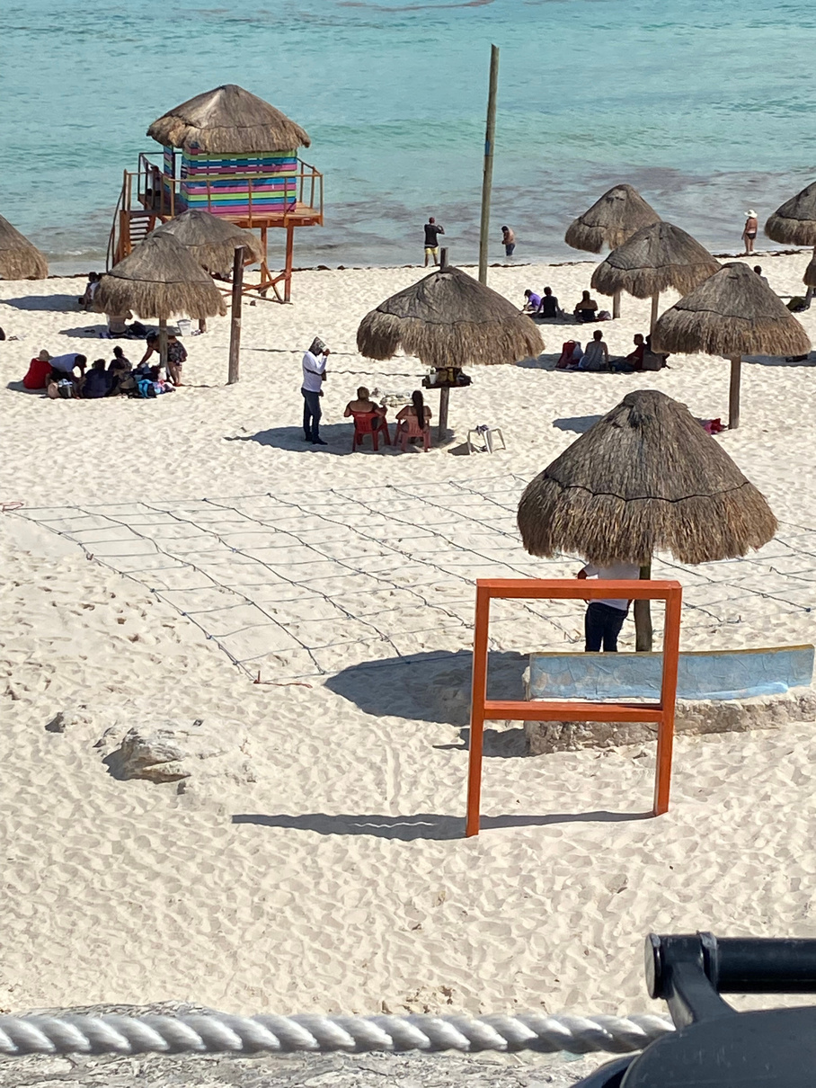
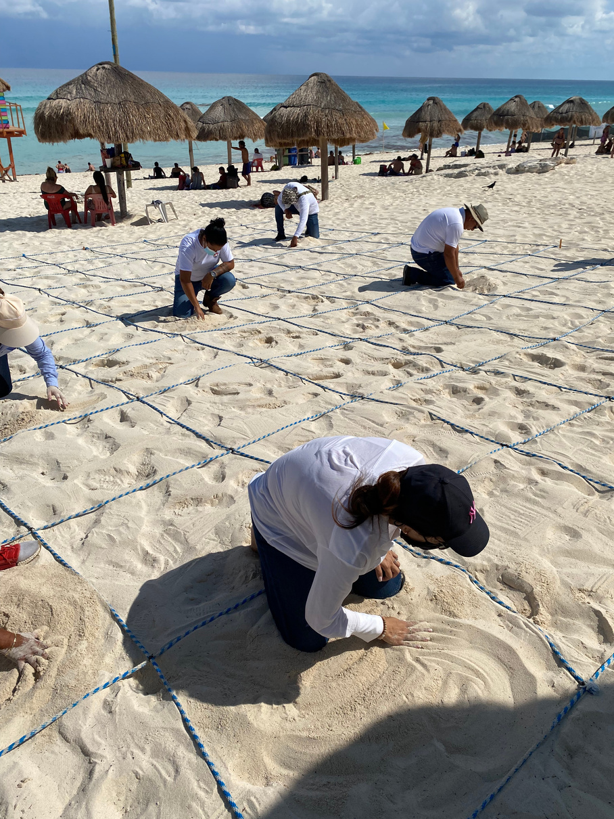

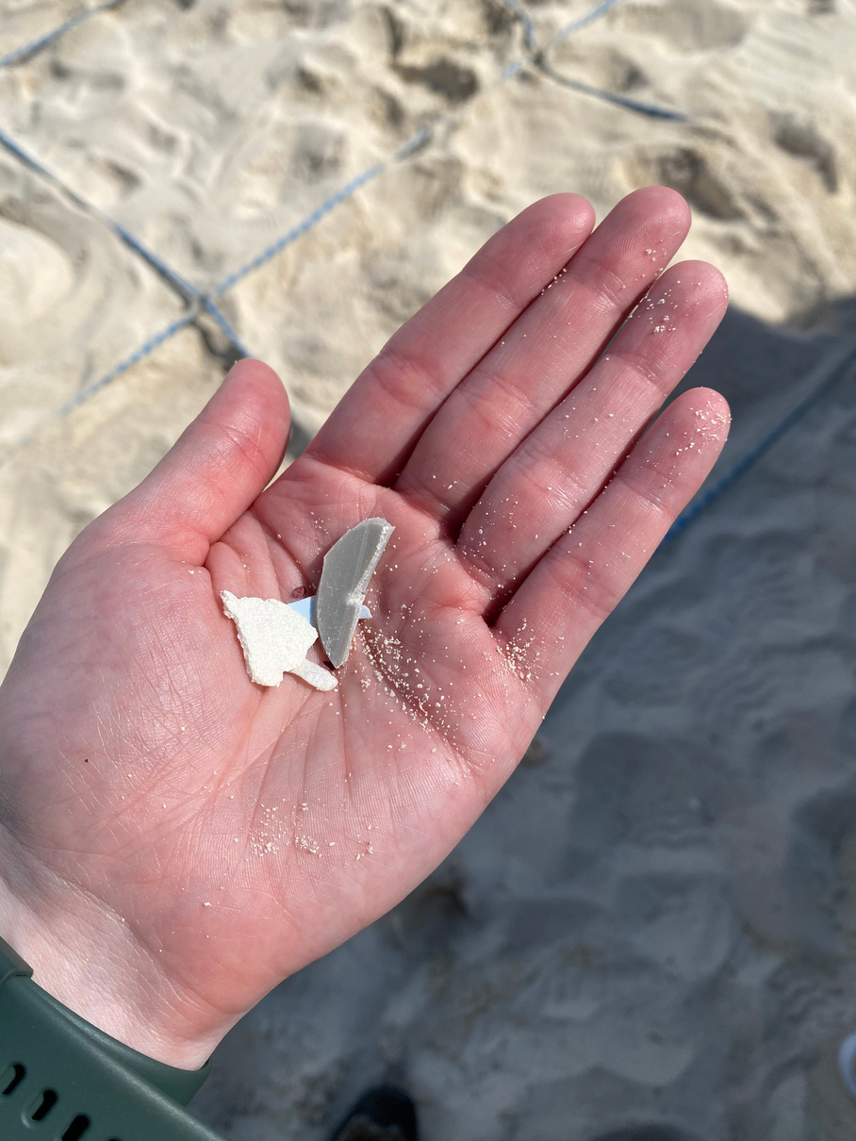

BEACH LITTER MEASUREMENT SYSTEM
appendix F
STEPS FOR MEASURING
The Beach Litter Measurement System (BLMS) is a grading system for how clean a beach is at a given point. This tool is looking for waste not natural debris. The process is outlined in Appendix F in the explanatory document. Below is a simplified set of steps based on the Mexican model.
Step 1
Lay out and secure the measurement grid.
Step 2
Pick 20 random squares.
Step 3
Sift the surface sand in the square (about 5cm deep) for debris.
Step 6
Step 4
Take a picture of the waste and
track the number of total waste
and frequency of each waste type.
Remove large waste debris or obvious micro plastics.
Step 5
Sift through the sand down to about 20 cm and remove any further debris.
Page 09

